Slide 1

Comparative Classification Analysis to Identify the Subset of Mice based on the Protein Data : KNN and Decision Tree
Lokeshwar Srinivasan

Slide 2

Goal :
Comparing the Classification models – K-Nearest Neighbors and Decision Tree built on Mice Protein Expression Dataset.
Description of Data :
Dataset contains data of 77 protein expression levels (numeric) and 4 Categorical columns
1080 0bservations
8 Class of Mice exists
Each class of Mice is described based on features Genotype, Behavior, and Treatment
Genotype : Control or Trisomic
Behavior : context-shock and shock-context
Treatment : memantine and saline

Slide 3
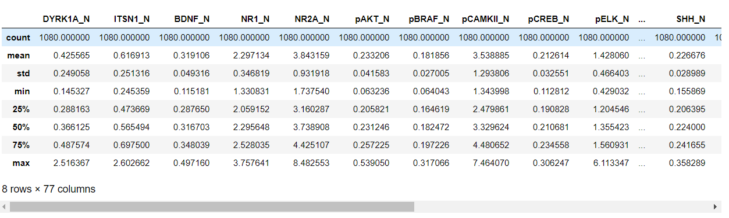
Data Statistics :

Slide 4
Preparation of Data
Data is Loaded on to workspace using pandas.
Learned the shape of the data
Learned the data types of the data
Check of null values or missing values
Replacing the missing values with the mean of the protein of the same class.

Slide 5
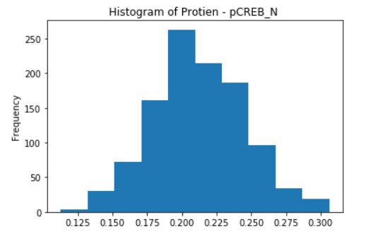
Question that I investigated…?
What is distribution followed by the numerical columns?
Distribution of the columns are known by plotting histograms.
For example, Histogram of Protein - pCREB_N as in the graph which represents that maximum number of mice has protein values between 0.18 – 0.24.
Hence, this histogram follows the normal distribution

Slide 6
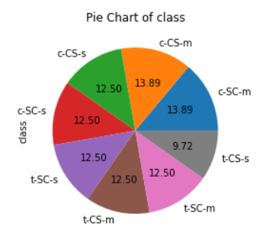
2. What is the distribution of target variable ?
Distribution of target variable can be known by pie-charts.
For example, Pie chart of ‘class’ variable
In pie- chart we can percentage distribution of each class.

Slide 7
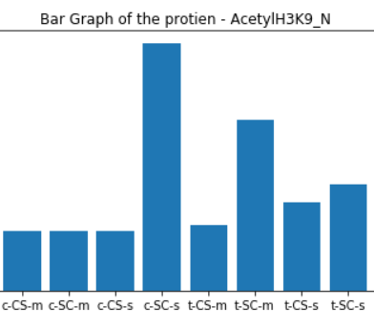
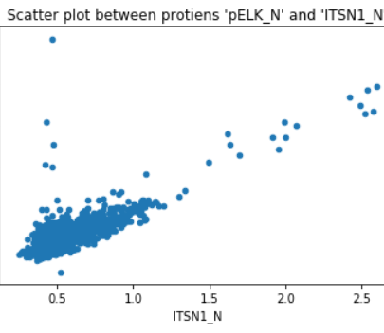
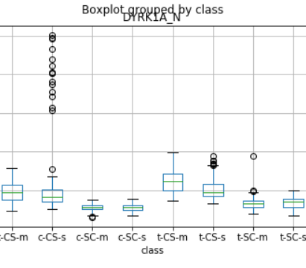
3. What is the relationship between the attributes?
Relationship between the attributes can be found by boxplot, bar chart and scatter plots.

Slide 8
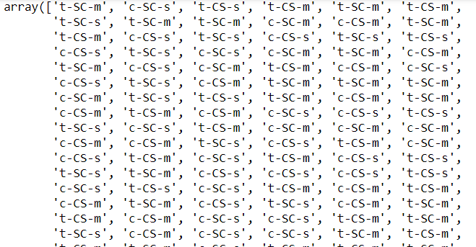
Data Model :
K- Nearest Neighbors
Model built by calling the method KNeighborsClassifier,
KNeighborsClassifier(n_neighbors = 5,weights = 'distance',p=1)
K- value = 5, weight follows distance calculated by using Manhattan
Model is trained by , knn.fit(X_train, Y_train)
Predicting the testing data, predictedK = knn.predict(X_test)

Slide 9
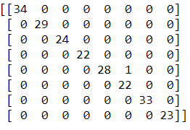
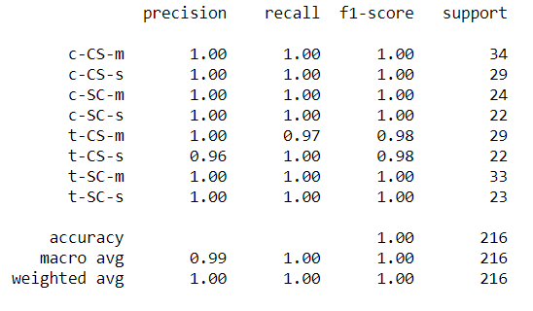
Confusion Matrix : No discrepancy between actual and predicted value
Classification Report : High precision, recall and F1-scores
KNN score : 99.53%

Slide 10
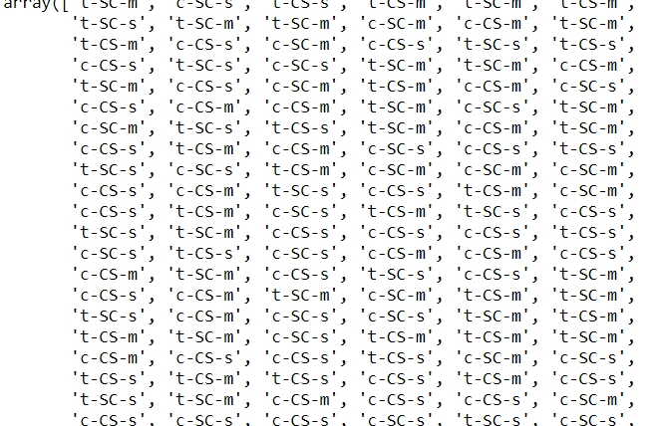
Decision Tree:
Built the model using , DecisionTreeClassifier()
Train the model by fitting the training data, dtc.fit(X_train, Y_train)
Predicted the test data using fitted data, dtc.predict(X_test)

Slide 11
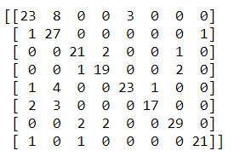
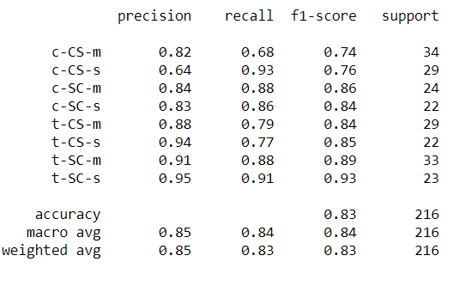
Confusion Matrix : Small discrepancy exists between actual and predicted values
Classification Report : Has low recall value
Decision Tree score : 83.33%

Slide 12
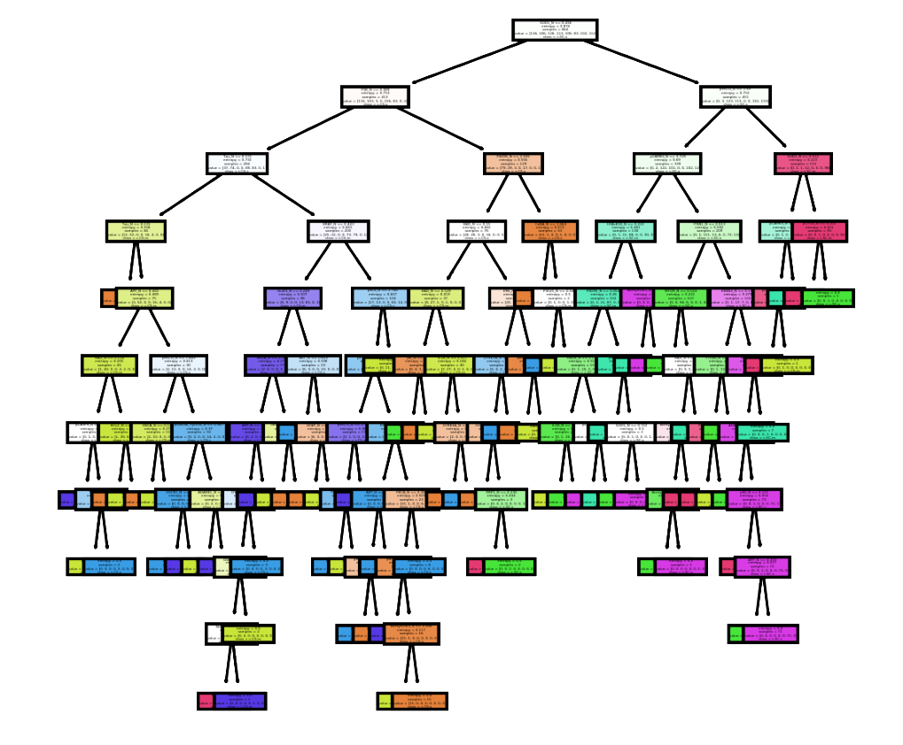
Decision Tree of Mice Protein Expression Dataset

Slide 13
Conclusion :
After the scores of the both classifications, KNN has the highest score and high precision, recall and F1-score compared to Decision tree.
Based on my research I can say that KNN is better classification model when compared with Decision Tree.

